Slide 1

Economics & Business
Lesson 7 – Types of Market

Slide 2
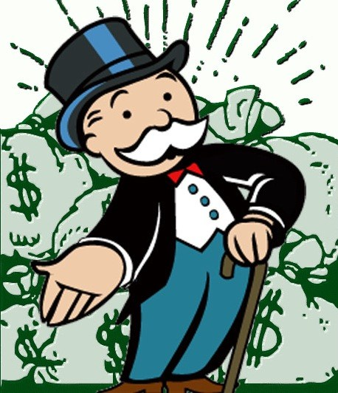
The Learning Intentions are:
Learn the 4 types of market
Identify the features of each market type.

Slide 3

The Market is…

Slide 4

A market refers to the relationship between the consumers and producers, rather than to any physical location.

Slide 5


Slide 6




There are 4 types of market:
retail markets
labour markets
Financial markets
stock markets

Slide 7


Four rhinos stood laughing

Slide 8



Slide 9

Draw a placemat:
Labour Market
Types of market
Financial Market
Stock Market
Retail Market

Slide 10
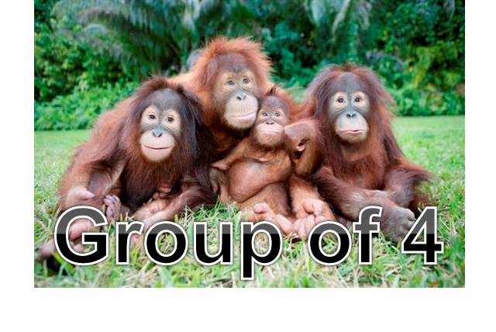

Slide 11
Noah
Bobby
Jasmine
Harrison
Freddie
Elizabeth
Kiara
Mack
Archie
Caitlyn
Ben
Shannon
Anya
Charly
Sophie
Millie
Eliza
Dan
Matthew
Andrei
Jorda
Aaron
Mitchell
Jacob
Caleb

Slide 12
Cam
Yudhir
Ellie
Abbey
Jared
Darcy
Olivia
Amy
Whitlam
Jordan
Andrea
Keeley
Jess
Benji
Mia
Emily
Macie
Jorja
Jade
Beth
Leia
Hazel
Toby
Ronan

Slide 13

Chapter 7.3
Turn to page 199
Read the section you have been allocated
Write key points/idea/phrases in placemat.

Slide 14

Share what you have learned-
talk it through!
Everyone should have a complete placemat.

Slide 15
Chapter 5.3
Read the remainder of the text.
Complete Questions 1-10.

Slide 16

PLENARY
One thing I need to review this evening is…
The most important thing I learned today was…
I would like someone to explain_____to me. I will ask_____
I will remember the 4 types of market with the mnemonic ….

